Slide 1
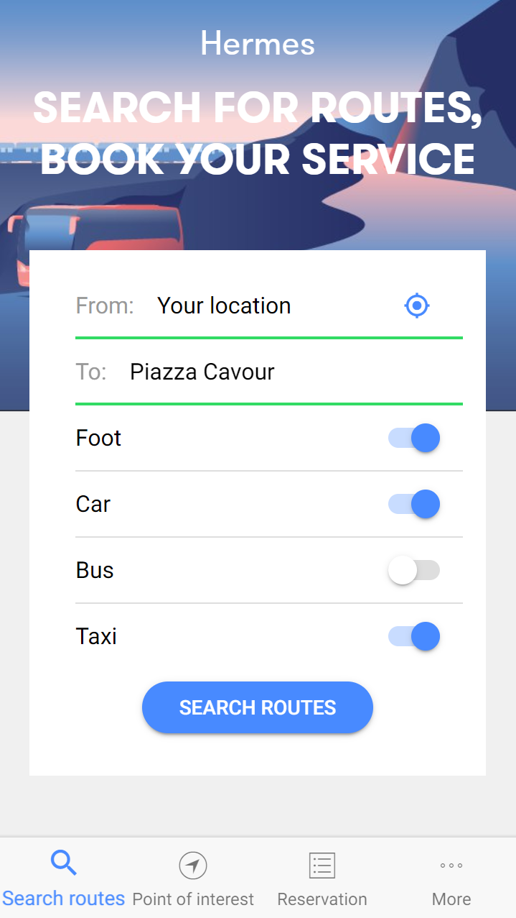
1- Write your trip waypoints here and select the services you are interested in
2- Press here to see the results

Slide 2
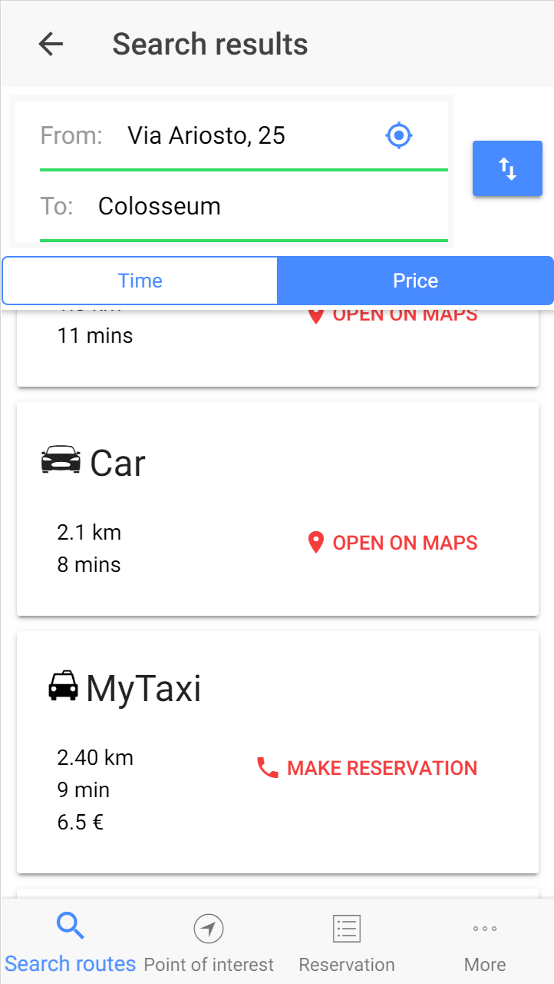
You choose here how to sort results -in ascending order - based on time or price
You see here time ,price and distance for every option.

Slide 3
Click here to swap them endpoints
You can modify your endpoints here
Click on the card to go on with your preferred option.

Slide 4
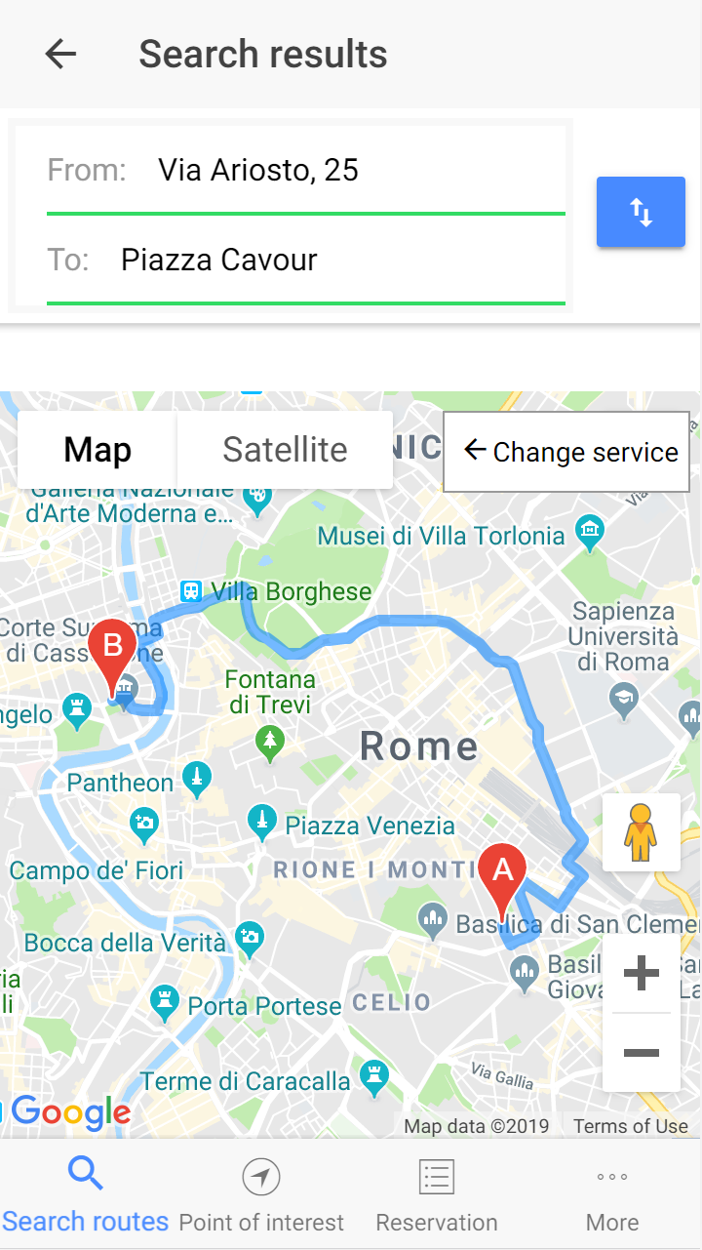
Here the route is shown on the map

Slide 5
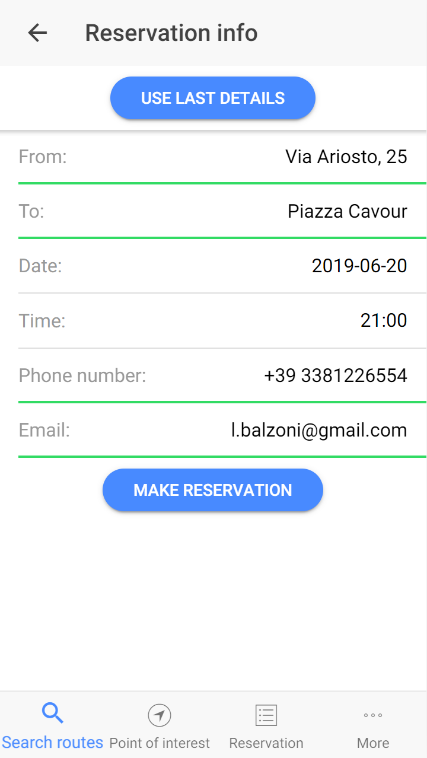
You can click here to automatically fill the form
Click here to confirm the reservation

Slide 6
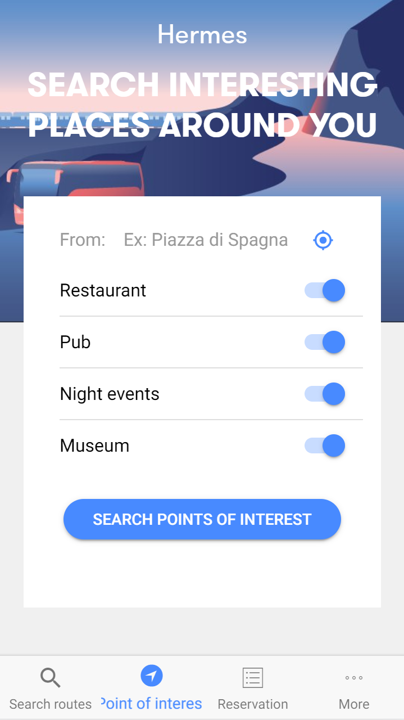
Select the starting position to search for attractive areas near it
Choose among different places you may be interested in and press “Search”

Slide 7
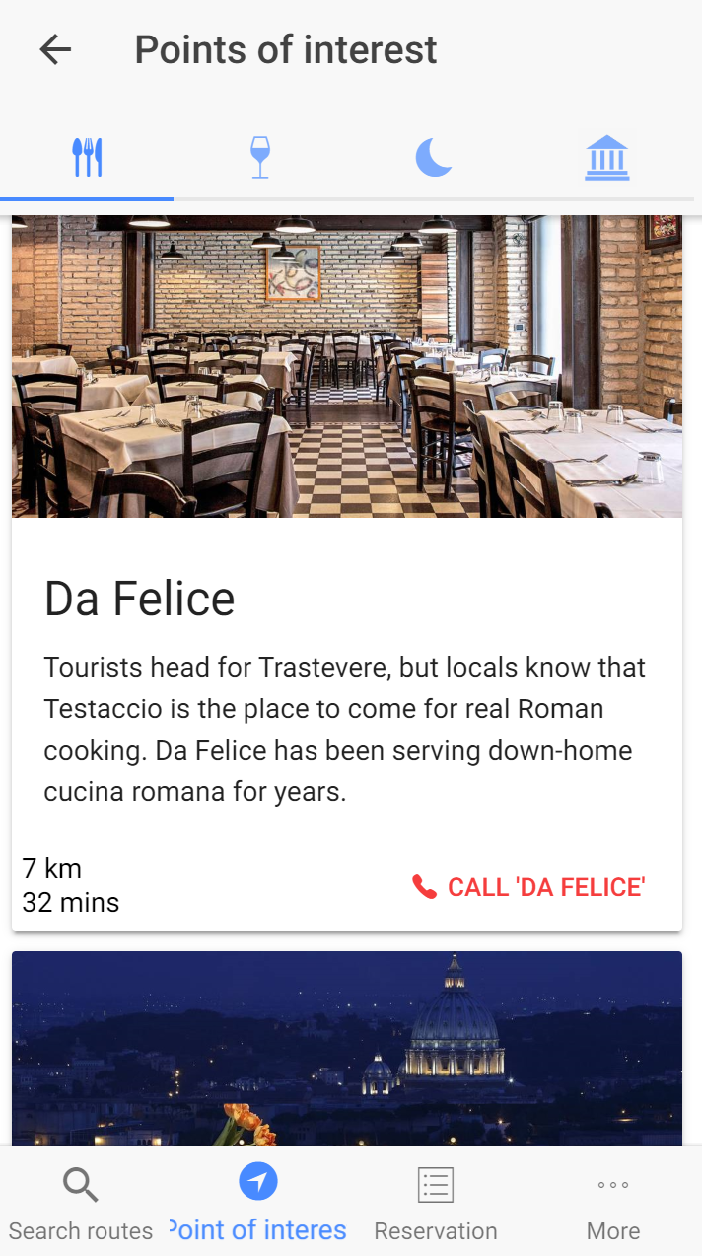
Here, various tabs for different places … you can simply click on the tab and see the suggested places

Slide 8
You see here the name of the place and a small description about it.
You call also choose to contact the place

Slide 9
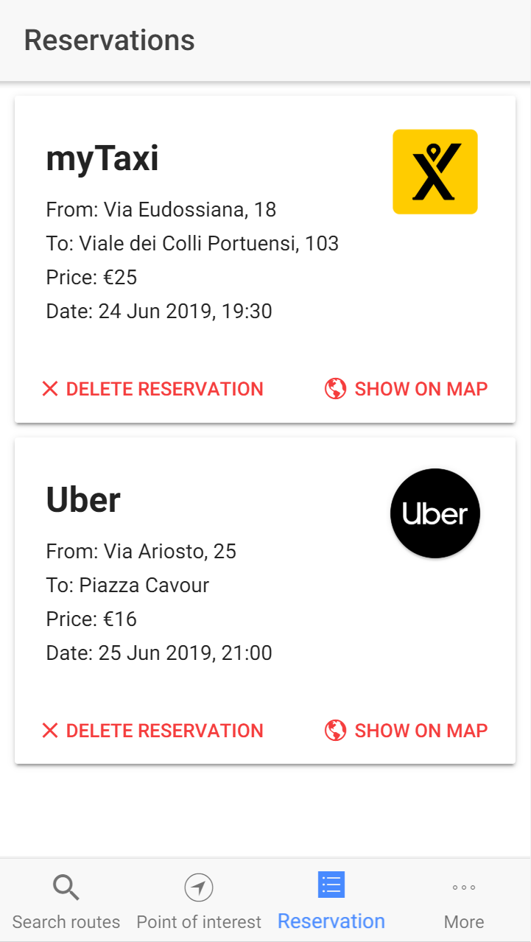
Details about your reservation
You can cancel reservation or show it on map

Slide 10
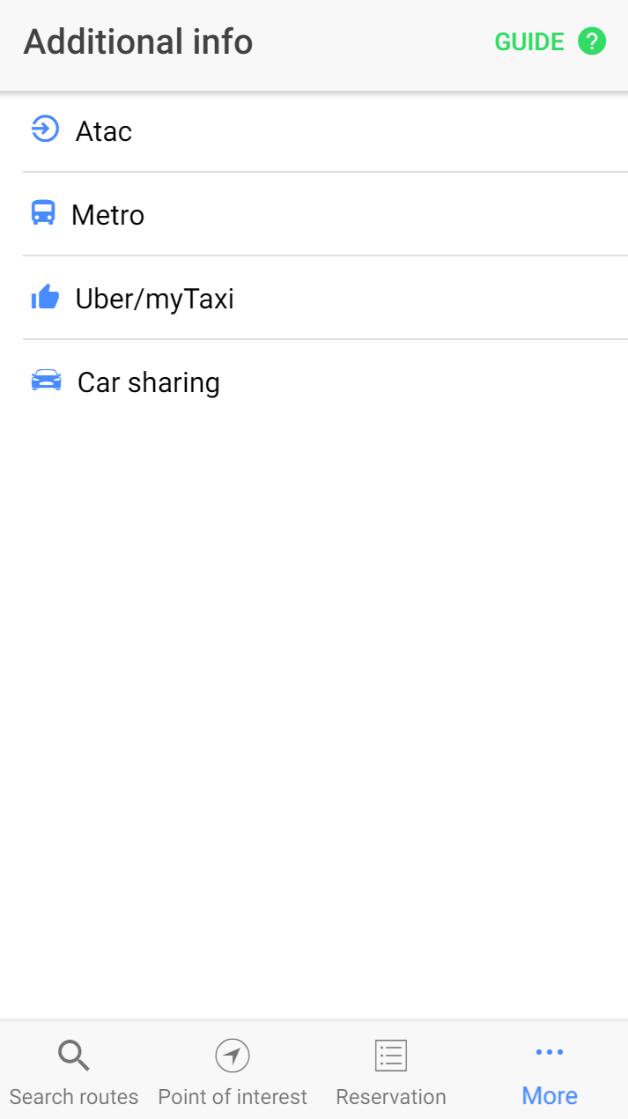
Choose the service to see useful information about them

Slide 11
To watch this tutorial again press here.
To open this tutorial click here

